Slide 1
Introduction to Sahaja Yoga
Grade 1, Nirmala Vishwa Vidya Peetham (Home School)
Notes:
Hi! My name is Virata! In this presentation I am going to give a short introduction to Sahaja yoga. I will explain about Sahaja Yoga, Kundalini energy, and about Self-Realization.

Slide 2
What is Sahaja Yoga?
In the words Sahaja Yoga, ‘Saha’ means ‘with’, ‘Ja’ means ‘born’, and ‘Yoga’ means union or connection with the univeral energy or God.
Sahaja yoga helps us easily awaken our inner energy called Kundalini to achieve this union and physically feel it as a cool breeze through a process called self-realization.
It is very simple and anybody can feel this experience.
Sahaja yoga is always free and is practiced in several countries around the world.
Shri Mataji Nirmala Devi is the founder of “Sahaja Yoga” meditation and has given this gift to humanity.
By practicing “Sahaja Yoga” meditation, we can always be joyful and peaceful, and achieve the highest state of human life.

Slide 3
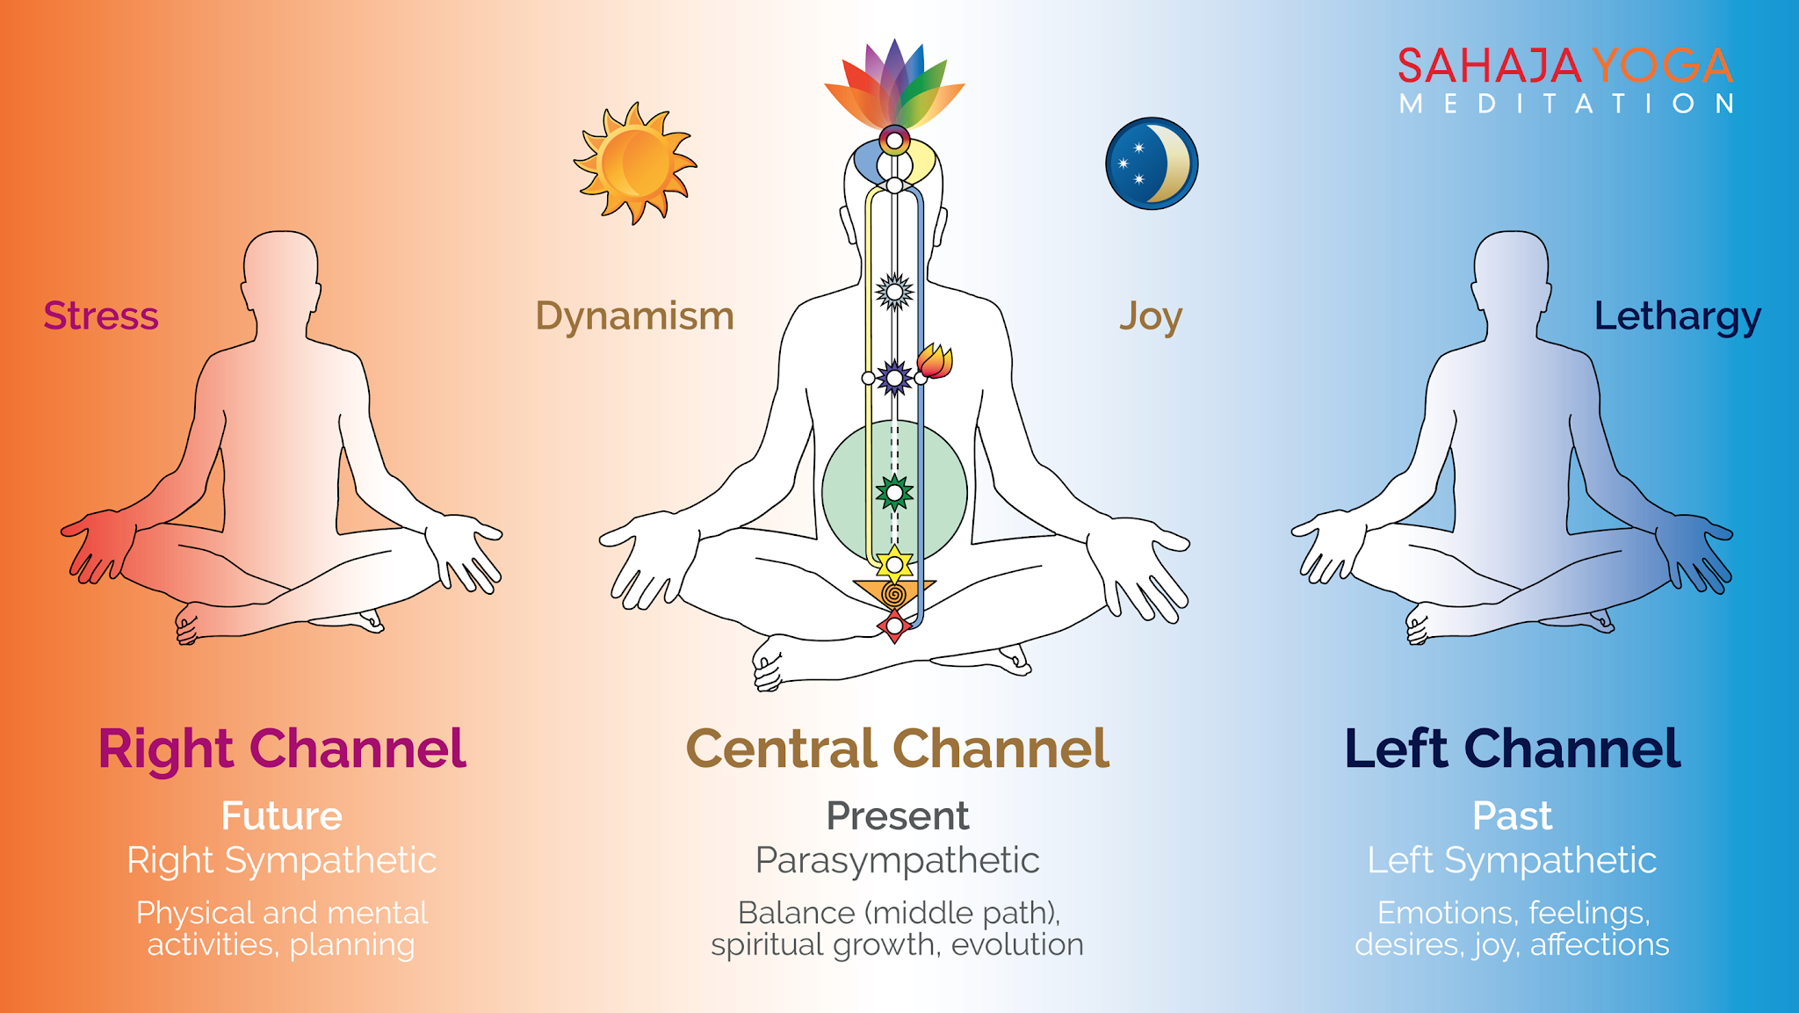
Chakras, Channels & Self-Realization
Chakras: Chakras are like energy centers located near diffferent parts of our spinal cord, and control our physical and mental states. Sahaja Yoga guides us on how to take care of our seven chakras: Mooladhara, Swadhisthana, Nabhi (Void), Anahata, Vishuddhi, Agnya, and Sahastrara. When our chakras are in balance, we will be healthy physically and mentally.
.
Channels: There are 3 Channels within us which control our past, present and future activities.
Kundalini energy: Kundalini energy is motherly energy inside us. It’s in the bottom of the spinal cord in a triangular bone.
Self-Realization: When our Kundalini energy rises and passes through all the chakras and reaches the chakra on top of our head, and gets connected with the divine energy around us, this is called Self-Realization. We can feel this in our hands and on top of our head as a cool breeze.

Slide 4
Benefits
When we practice Sahaja Yoga meditation everyday morning and evening (around 5 to 10 minutes), and meditate in a group (called as collective meditation) at least once a week, it helps us in many ways:
It cures all physical, mental, and emotional problems
It makes us peaceful, and always keeps us in balance
It gives us good health, and happiness
It teaches us to help each other, and enjoy as a group
It will make us free from stress, and tensions

Slide 5
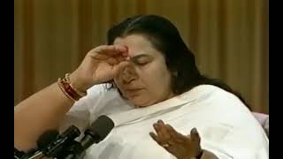
Experience Self-Realization by Shri Mataji

Slide 6
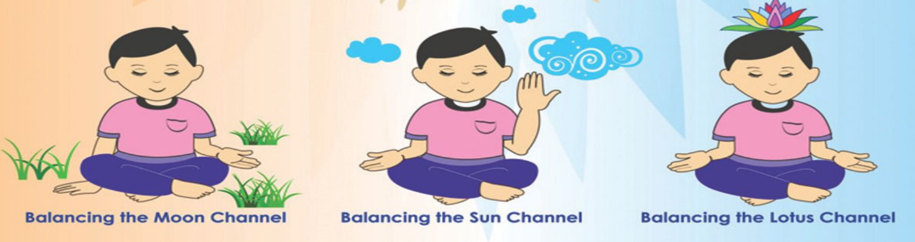
Daily meditation
We can follow these simple steps to remove imbalances and then sit in silent meditation for a few (~10) minutes to feel the cool breeze and peacefulness. This is called Meditation.
Mother Kundalini, please balance my Left channel
Mother Kundalini, please balance my Right channel
Mother Kundalini, please keep me in the present. Please give me self-realization.

Slide 7
Collective meditation & References
Collective meditation is very important because we can feel calmness, easily improve our meditation and learn techniques to keep us in balance.
Meditation-at-Home-Booklet This short introductory booklet gives you more details about Sahajayoga and how you can meditate everyday.
To attend Sahajayoga collective meditation near your location, you can lookup ‘Sahajayoga <city/country> name’ in Google/Meetup.
More information about Sahajayoga and center locations can be found here:
sahajayoga.org
freemeditation.com
https://www.sahajayoga.org.in/

